Slide 1
Telecommunication & Observation SYSTEM
Case Study: Requirements definition

Slide 2
Stakeholders requirements definition
Part 1

Slide 3
Activities
Identify
Define
purpose and mission
Delimit
Understand Dynamics
Define functional
boundaries
Identify
situations of life
and stakeholders
Develop Requirements
Define
operational
scenarios
Define physical
boundaries
Express each
stakeholder
requirement individually
Define operational concepts or technological concepts
Define
operational conditions
Quantify
and classify
the needs
Define expected
measures of
effectiveness
(performances)
Verify consistency,
exhaustiveness and establish traceability

Slide 4
Case study
Identify
Identify the purpose of the system
Why does the system exist ? What for ?
Identify the mission of the system
What does it do ?
Define the objectives of the system
What level of performance/efficiency ?
Define
purpose and mission
Identify
situations of life
and stakeholders

Slide 5
Case study
Identify
Purpose of the System
The purpose of the System is to improve the Civil Security capacities to protect forest from fires.
Missions
The missions of the System are to detect autonomously new fires on a specified surveillance area, to observe existing forest fires and provide information to the fire fighting forces.
Objectives
Availability 24 hours/day
Range of action: 100 km
…
Define
purpose and mission
Identify
situations of life
and stakeholders

Slide 6
Case study
Identify
Define
purpose and mission
Identify the stakeholders
Focus on the Operation phase
Identify external actors
Persons or organisations (operators who will operate or maintain the system, users who will exploit it)
Other systems interacting with or constraining the System of Interest
Identify
situations of life
and stakeholders

Slide 7
Phases
Typical phases (situations of life)

Slide 8
Context of use
Stakeholders, objects, systems in interaction with the TOS
Stakeholder | Description
Civil Security Control Center | The CSCC coordinates all the fire fighting ressources, and orders missions to the TOS.
Fire Fighting Services | Air and Ground services, clients for observation data
Transportation | Transportation means to/from the operating base
Maintenance Departement | Logistics base for the TOS
Online Positioning System | Online system providing 3D position
Energy Supplier | Provides energy on the operation base
National Geographic Institute | Provide electronic 3D maps
Air Traffic Management | Validates the flight plan
Telecoms | Telecoms services, including for the surveillance zone

Slide 9
Case Study
Delimit
Define functional
boundaries
Identify the service functions
Functions of the systems with respect to external actors
Apply the Octopus method
You can model the result with a use case diagram
Define physical
boundaries
Define operational concepts or technological concepts

Slide 10
Functional context
Environment
Constraints
Operator
Service function
System of Interest
User
Service function
Other
system
Service function
Service function
Maintenance
Service function: Expected system function, considering the system as a black-box (no information on the function implementation).

Slide 11
External Functional Analysis: Principal Functions
Forest
Civil
Security
Command
Center
PF4
Forest Fire
PF2
PF3
PF1
TOS
Fire
Fighting
Services
PF 1: Allow the CSCC to survey a Forest
PF2: Allow the CSCC to detect of a new Forest Fire
PF 3: Allow the CSCC and the FFF to observe an existing Forest Fire
PF 4: Allow the CSCC to coordinate the FFS

Slide 12
External Functional Analysis: Constraint Functions
Telecoms
Air Traffic Management
Online positioning system
TOS
National Geographic Institute
Energy Supplier
Transporter
FC1
Maintenance Department
All others are Constraint functions. Example:
FC 1: Provide health status to the Maintenance Department

Slide 13
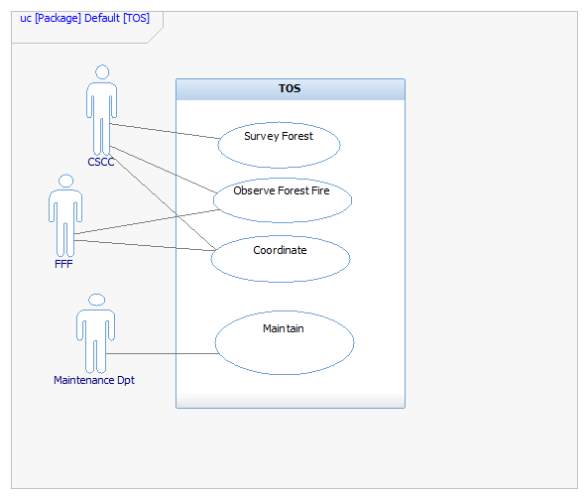
TOS Use Case

Slide 14
Case Study
Delimit
Define functional
boundaries
Identify the Physical interfaces
Define physical
boundaries
Define operational concepts or technological concepts

Slide 15
Physical context
Environment
Constraints
Operator
System of Interest
Physical interface
User
Physical interface
Physical interface
Other
system
Physical interface
The physical interface is the link which will support the corresponding service function. It can be:
A physical connector
A contact between physical surfaces
A communication protocol
An input or communication device
…
Maintenance

Slide 16
Online Positionning system
CSCC
SatCom
SatCom
FFS
System of interest
Power Plug
Energy Supplier
Radio signal
TOS
SatCom
Transportation
package
Maintenance Dpt
Power Plug
Transportation
Internet
Radio signal
National Geographical Institute
Air traffic Management

Slide 17
Case Study
Delimit
Define functional
boundaries
Identify the operational concepts
"Operational concepts" are general way or approach or strategy of operation / utilization: basic options of how will be used the system in operation / in service.
Example: a completely automated system, or a system which let human to decide on operation tasks and to make decisions.
Define physical
boundaries
Define operational
concepts
or technological
concepts

Slide 18
Case Study
Delimit
Define functional
boundaries
Identify the technological concepts
"Technological concepts" are technological options for the global usage of the system.
Example: a solution which is based on "electronic" or "pneumatic" technology
Define physical
boundaries
Define operational
concepts
or technological
concepts

Slide 19
Case Study
Understand Dynamics
Describe the following operational scenarios
1) From initial storage to the detection and observation of a fire
2) Detection and correction of a system failure
… with sequence diagrams
Define
operational
scenarios
Define
operational conditions
Define expected
measures of
effectiveness
(performances)

Slide 20
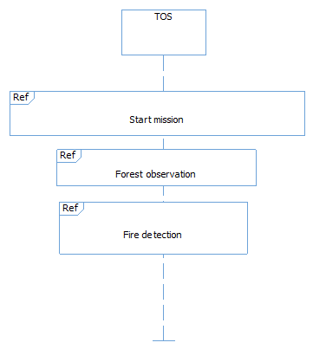
Complete scenario

Slide 21
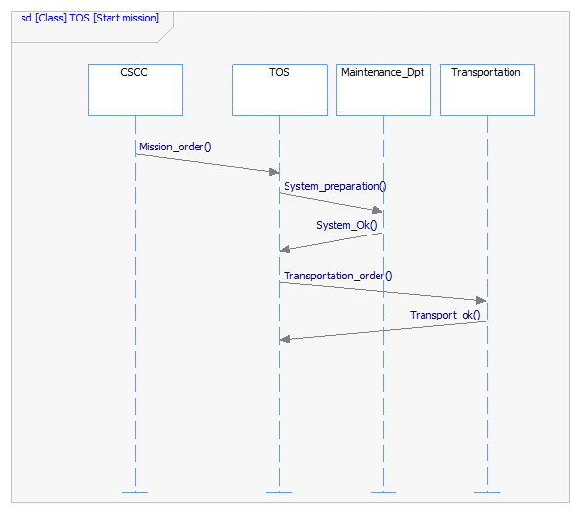
Start mission part

Slide 22
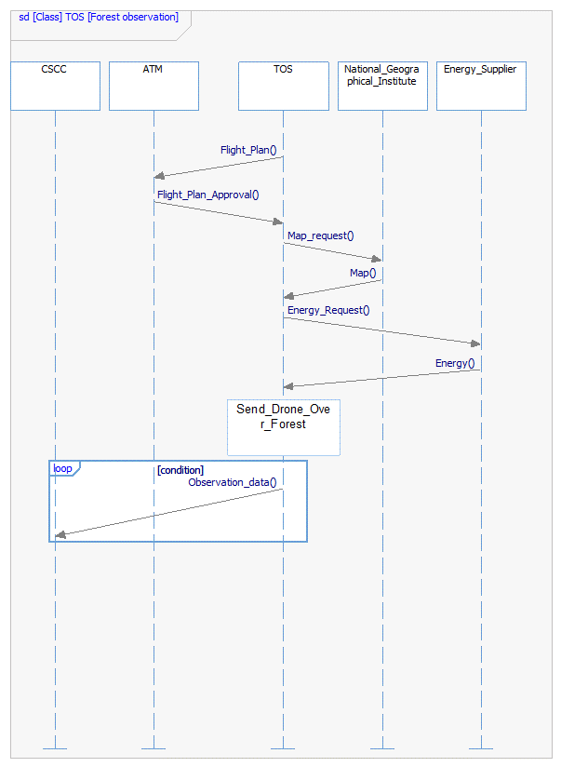
Forest observation part

Slide 23
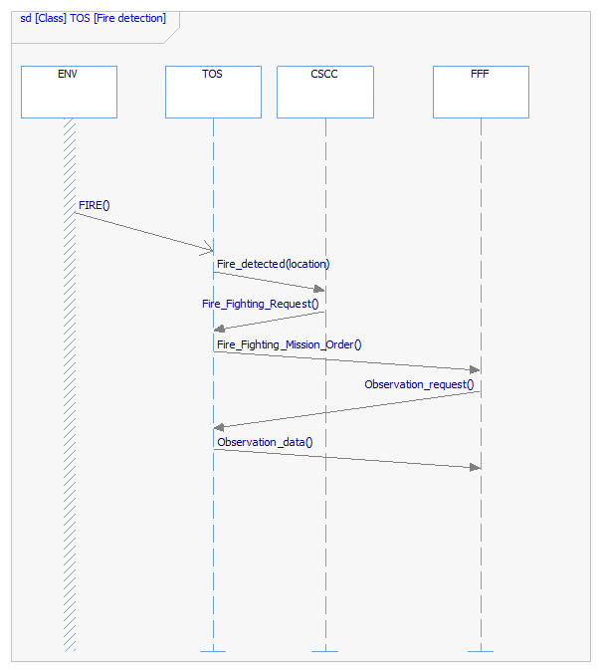
Fire detection part

Slide 24
Case Study
Understand Dynamics
Identify the main operational conditions
From the initial needs
… and more if needed
Define
operational
scenarios
Define
operational conditions
Define expected
measures of
effectiveness
(performances)
Notes:
The operational conditions express conditions of execution (example : availability, safety, security, human factors, environmental conditions).
Operational constraints are added, for instance physical dimensions or imposed solutions.

Slide 25
TOS operational conditions
Understand Dynamics
Flying drone
Entire district
Any weather conditions
Availability 24/24
Authorized human operator
Transportable
Into operation in a minimum of time
Define
operational
scenarios
Define
operational conditions
Define expected
measures of
effectiveness
(performances)

Slide 26
Case Study
Understand Dynamics
Identify performances
From the initial needs
… and more if needed
Define
operational
scenarios
Define
operational conditions
Define expected
measures of
effectiveness
(performances)

Slide 27
Case Study
Understand Dynamics
Range 100 km
Visual observation 10 km²
Infrared observation 3 km²
Operational during 6 days
Operational during an entire disaster episode
Define
operational
scenarios
Define
operational conditions
Define expected
measures of
effectiveness
(performances)

Slide 28
Usefulness of classification
Sorting requirements into categories allow to simplify their interpretation
Operational requirement | Identify the situations of life to be taken into account and the corresponding operational conditions
Functional Requirement | Know the various transformations to be operated on energy, material and information
Measure of effectiveness | Define the field of application of these transformations
Constraint | Identify the limits applicable to physical architectures and to components
Interface | Participate to exchanges between various sets
Validation | Take into account the various elements of validation which have an impact on architectures

Slide 29
Case Study
Develop Requirements
Define the Stakeholder Requirements
expected services
expected performances
expected interfaces
operational conditions
Constraints
Validation
.. from the initial needs, and the previous analysis and diagrams
Express each
stakeholder
requirement individually
Quantify
and classify
the needs
Verify consistency,
exhaustiveness and establish traceability

Slide 30
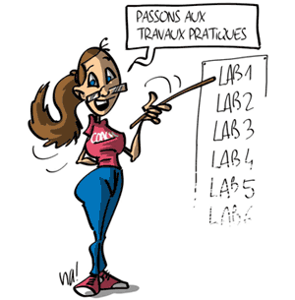
Exercise
Telecommunication and Observation System
Write down some Service requirements of the TOS
Guidelines
Use case and operational scenarios are
good sources for service requirements
Time: 15 min

Slide 31
StakeHolder requirements (service)
Reformulation and refinement of initial « service » needs

Slide 32
Exercise
Telecommunication and Observation System
Write down some Performance requirements of the TOS
Guidelines
Typical sources:
Needs with quantitative or qualitative
Information
Time: 10 min

Slide 33
StakeHolder Requirements (Performances)

Slide 34
Exercise
Telecommunication and Observation System
Write down Operational conditions requirements of the TOS
Guidelines
Typical source: any need related to « when »,
« where », « under which conditions »
Time: 10 min

Slide 35
StakeHolder requirements (Operational Conditions)

Slide 36
StKReq60 TOS shall operate in any weather conditions

Slide 37
Exercise
Telecommunication and Observation System
Write down Interface requirements of the TOS
Guidelines
Typical sources are the context diagrams
Time: 10 min

Slide 38
Stakeholders requirements (Interface)
Obtained from the functional context, physical context and operational scenario

Slide 39
Exercise
Telecommunication and Observation System
Write down Constraints requirements of the TOS
Guidelines
Typical sources is regulations
Time: 5 min

Slide 40
Stakeholders requirements (Constraints)

Slide 41
Exercise
Telecommunication and Observation System
Write down Validation requirements of the TOS
Time: 5 min

Slide 42
Stakeholders requirements (Validation)

Slide 43
Stakeholder Requirements Definition Process
Stakeholders
Requirements
document
Requirements
Analysis
Technical
Requirements
Document
The purpose is to transform the stakeholder, requirement-driven view of desired services into a technical view of a required product that could deliver those services

Slide 44
Activities of the System Requirements Definition Process
Analyse
Analyse operational scenarios and modes
Define
Constrain
Define
functional
requirements
Analyse boundaries
and interactions
with the context
Develop Requirements
Define
Lifecycle
constraints
Define performance
requirements
Express each
technical
requirement individually
Define interface requirements
Define physical
constraints
Verify consistency,
exhaustiveness and establish traceability
Define
operational Requirements
Notes:
Note: Write preferably measure of effectiveness requirements (performance requirements) separately from functional requirements, because during design, it is possible that such a requirement is allocated to several functions.

Slide 45
Case Study
Define
Identify the technical functions supporting the service functions of the system
Define
functional
requirements
Define performance
requirements
Define interface requirements
Define
operational Requirements

Slide 46
Case Study
Define
Analyse two Stakeholder Requirements of each category and refine them into technical requirements
expected services
expected performances
expected interfaces
operational conditions
Constraints
Validation
Define
functional
requirements
Define performance
requirements
Define interface requirements
Define
operational Requirements

Slide 47
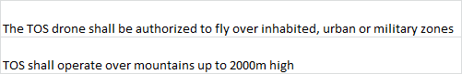
Technical requirements
Examples
Technical requirements

Slide 48
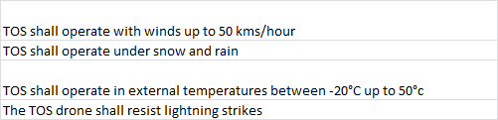
Example (Op Conditions)
Stakeholder requirement
Technical requirements

Slide 49
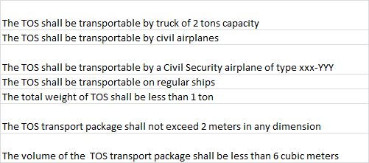
Example
Stakeholder requirement
Technical requirements

Slide 50
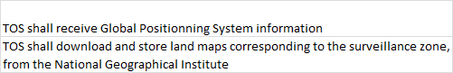
Example
Stakeholder requirement
Technical requirements
New external system/stakeholder

Slide 51
Detailed analysis
Analyse
Identify a first level physical(organic) architecture of the system
Identify internal sub_systems
Define their interface and interactions
SysML tool: Internal Block Diagram
It can be useful to extend the existing operational scenarios (Sequence Diagrams) with the new elements
Analyse operational scenarios and modes
Analyse boundaries
and interactions
with the context

Slide 52
Verification&Validation
Part 3

Slide 53
Verify these requirements
The display shall be bright blue or yellow
The system is able to operate in daylight conditions
The hull of the satellite shall be water-proof
The fuselage shall be 100% resistant to impacts
The speed of the cooling fan shall be 10000 rpm (TBC)
The termination resistors shall not be located on the main board
The FCSC shall have a MTBF of more than six months
The main calculator shall be composed of two computers with an Ethernet connection

Slide 54
Rate these requirements
The display shall be bright blue or yellow
What will be the chosen color ?
The system is able to operate in daylight conditions
No shall !
“Daylight conditions” is often not precise enough. →”The system shall operate with lights conditions equal or less than 200 lumen”
The hull of the satellite shall be water-proof
Probably not relevant for a satellite to be water-proof
The fuselage shall be 100% resistant to impacts
Not feasible ! One should say up to which strength it resists
→ “The fuselage shall resist to impacts up to 200 kilos/cm²”

Slide 55
The speed of the cooling fan shall be 10000 rpm (TBC)
TBC (To Be Confirmed)→ when will it be confirmed ?
The termination resistors shall not be located on the main board
Negatives form ! Where the resistors should be ?
→ “The CAN Bus termination resistors shall be located on the Power Supply board
The FCSC shall have a MTBF of more than six months
Acronyms can be ok, is they are really known across all the company, or are coming from standards
→”The Flight Control Secondary Computer shall have a Mean Time Between Failures of more than six motnhs”

Slide 56
The main calculator shall be composed of two computers with an Ethernet connection
Design solution ! this is an architecture choice, with a design choice.
-> “The main calculator shall accept a Mean Time Between Failures of 15000 hours”

Slide 57
Case Study
For each technical requirement:
Verify that it is of good quality
Identify one verification mean
Identify one verification objective
Link the requirement to the corresponding stakeholder requirements
SysML tool: requirement diagram
Develop Requirements
Express each
technical
requirement individually
Verify consistency,
exhaustiveness and establish traceability

